Slide 1
National DER Connection Guidelines – Basic and Low Voltage Connections
Webinar
7th March 2019

Slide 2
Agenda
Overview of intent and development process of the guidelines
Compliance to the guidelines
Feedback received from stakeholders
Follow on actions
Next Steps – MV & HV Guidelines
Questions
Presenters
Dr Stuart Johnston (GM Network Transformation – Energy Networks Australia)
Tim Edwards (Managing Director – CutlerMerz)
Sanika Willard (Consultant – CutlerMerz)

Slide 3
Housekeeping
‘On hold’
DO NOT put us ‘on hold’, as this will prevent us from presenting the audio.
Questions
please utilise the dialogue box function to record any questions you would like to pose to the presenters to address at the end of the presentation. Due to the number of participants on the webinar, you will not be able to talk directly to the presenters.
Please ensure you include enough detail in your question for the presenters to be able to easily understand your issue.

Slide 4
Overview

Slide 5
National DER Network Connection Guidelines
A series of guidelines which set out the structure, definitions and technical settings Australian DNSPs should adopt in the development and application of their technical requirements for grid connection of distributed energy resources (DER).
The guidelines use instructional language directed towards network service providers (NSPs) in developing and applying their technical requirements
Note:
The guidelines are intended to address current technical requirements, as “point in time” type documents.
Future technical requirements are being identified and described through the Energy Networks Australia / Australian Energy Market Operator (AEMO) “Open Energy Networks” (OpEN) program of work.
As requirements shift from “future” to “now”, revisions of the guidelines will capture these changes.
Notes:
Open Energy Networks consultation aim to identify
Need for common standards and protocols for active DER
Technical requirements (yet to be developed)
ENA’s OpEN project and DER Connection Guidelines will be coordinated in a manner that progressively increases uptake of DER while reducing network risks

Slide 6
Documents
Framework and Principles Guideline
Specifies the number, scope and structure of the subsequent technical guidelines
Any voltage less than 1000VAC
Any voltage greater than 1000VAC
Basic Connections Technical Guideline
Specifies the technical requirements and/or technical outcomes to be achieved for basic connections (<30kVA microEG connections)
Low Voltage Connections Technical Guideline
Specifies the technical requirements and/or technical outcomes to be achieved for all other connections to a low voltage network
Medium Voltage Connections Technical Guideline
Specifies the technical requirements and/or technical outcomes to be achieved for connections to a medium voltage network
High Voltage Connections Technical Guideline
Specifies the technical requirements and/or technical outcomes to be achieved for connections to a high voltage network

Slide 7
Who do the guidelines Basic & LV Guidelines apply to?
Stakeholder Type | Directly applies? | How guidelines should be used
Distribution Network Service Providers | ✓ | To directly adopt in the development and application of their technical requirements for grid connection of DER
Transmission Network Service Providers | ✗ | To consider (principles) in developing technical requirements for grid connection
Proponents | ✗ | To navigate and understand the technical requirements for connection to Australian networks
AER | ✗ | To assist in determining whether the technical requirements as proposed by DNSPs (in model standing offers) are fair and reasonable
Other stakeholders | ✗ | To navigate and understand the technical requirements for connection to Australian networks

Slide 8
Desired outcomes
Increase consistency between NSPs in terms of technical requirements, documentation requirements and structure of technical requirements documentation
Improve clarity with respect to technical requirements
Strike the right balance between:
Mitigation of network risks / network costs
Efficiency in the connection process
In terms of the level of onerousness of technical requirements
Establish a platform for NSPs to develop common standards and protocols for future management of active DER

Slide 9
How will Energy Networks Australia ensure the guidelines remain relevant given the rate of change regulatory and technical settings?
The guidelines will be reviewed annually by Energy Networks Australia to identify whether there is a technology or regulatory trigger for update
An independent evaluation will be conducted to determine:
The level of compliance
Whether the desired outcomes have been achieved from both an NSP and proponent perspective
Guideline review and implementation evaluations
The first review will occur six months after publication
The first independent evaluation will occur one year after publication
Independent evaluation will be conducted every two years thereafter

Slide 10
How did we develop the technical settings?
Direct engagement with primary stakeholders through meetings and workshops with a cross section of the industry, including:
DNSPs
Clean Energy Council (CEC)
Australian Energy Market Operator (AEMO)
Australian Energy Market Commission (AEMC)
Quarterly briefings to the Energy Networks Australia Asset Management Committee (representing all NSPs)
Two public webinars
Draft revision process via email submission from each DNSP and stakeholders such as the CEC and AEC

Slide 11
Principles in developing technical requirements
Deliver consistency
Improve clarity and transparency
Balancing network risk with connection efficiency (reducing unnecessary onerousness)
Creation of a process that can quickly respond to changing requirements of the industry
Promoting innovation

Slide 12
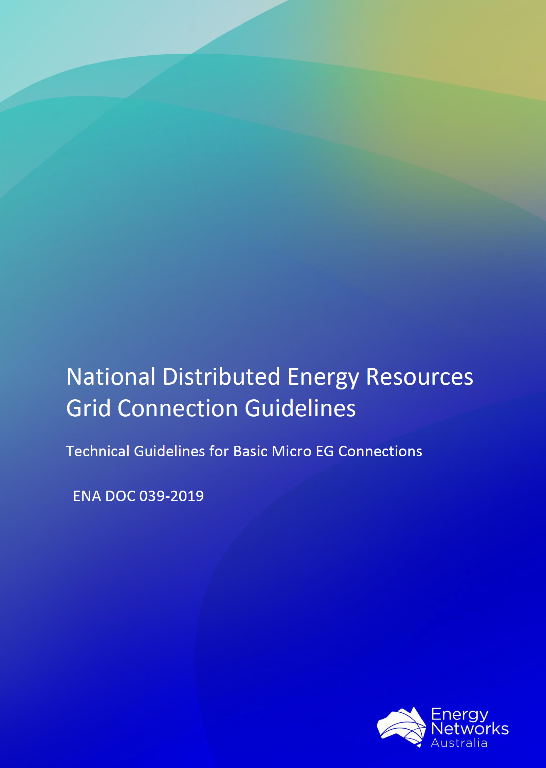
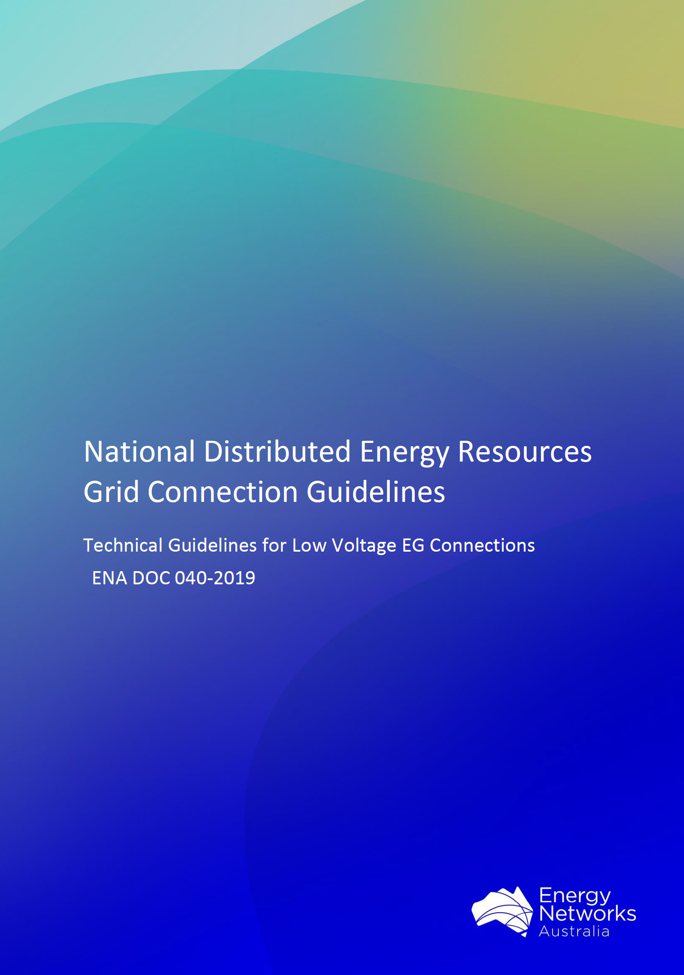
Feedback on Basic & LV Guidelines

Slide 13
Summary of Basic and LV Connections Guidelines Contents
About the National DER Connection Guidelines (overview, background, objectives, compliance, etc.)
How DNSPs are to prepare the LV EG Connections Technical Requirements document including:
Introduction of the DNSP Technical Requirements document
Definitions, abbreviations and terminology used
Relevant Rules, Regulations, Standards and Codes
Technical requirements of grid connections
Fees and charges
Testing and Commissioning requirements
Operations and Maintenance requirements
Appendices including: Deviations with justifications, Connection arrangement requirements and connection agreements

Slide 14
Key themes covered by external stakeholder feedback
Guidelines: objectives, audience and iterations
Australian/International standards
Expediency in processing embedded generation connections
Voltage response modes
Energy storage systems
Generation control
Non-standard network connections
Maximum System Capacity
Compliance
Energy Networks Australia Communications piece and transition plan

Slide 15
Guidelines: Objectives, Audience and Iterations
Guidelines aim to establish the structure, definitions and technical settings that DNSPs should adopt for their technical requirements for grid connection of DER
Audience of guidelines are DNSPs, as the guidelines provide a template for the development of their individual technical requirements documents
Suggestion regarding the need to empower consumers with access to information about their investment choices
Purpose of consistency vs specificity
Process of evolving the guidelines

Slide 16
References to Australian/ International Standards
References to standards bring specificity/clarity for consumers and minimise confusions
Solar PV is the most prevalent DER technology installed across Australia. Technical requirements for ESS and other DER technologies are intended to be introduced in future iterations of the guidelines.
Guidelines are not an explanatory document
Reminder that the guidelines are DNSP facing only

Slide 17
Expediency of Processing Basic EG Connections
Timeframes for assessments of applications and connections
Basic connections guideline will enable expediency in processing
Other connections will need to meet the slightly more negotiated requirements
Consistency introduced by the guidelines into the DNSP technical requirements documents

Slide 18
Voltage Response Modes
Volt-var and volt-watt response modes contribute to network voltage regulation and can ultimately encourage further DER penetration
Energy Networks Australia will be working closely with AEMO and DNSPs to develop volt-var and volt-watt settings that are forecast to be incorporated into the next iteration of the guidelines (with fixed power factor references removed altogether once the transition period is complete).

Slide 19
Incorporating Energy Storage System (ESS) Technical Requirements into the Guidelines
Future iterations of the guidelines are intended to incorporate further ESS requirements
Consideration for ESS guideline to be introduced after the MV/HV guideline is completed
Currently ESS is intentionally referenced for the purpose of improving consistency without introducing any constraints on battery operation or capacity
ESS is defined as a system of one or more batteries
It is intended for the guidelines to be technology agnostic, however there is focus on prominent DER technologies such as solar

Slide 20
Generation Control
Basic connections have generation control limits so that can be made consistent
Setting the single phase Inverter Energy System (IES) export limit of 5kVA or higher is achievable
Promote network security whilst also allowing customers to maximise export to the grid
Demonstration of compliance to generation control settings
Generation control will be influenced by developments in dynamic management and VPP trials, OpEN and individual DNSP research and development programmes.

Slide 21
Non-Standard Network Connections (Basic EG Connections)
‘Non-standard network connections’ typically have their own set of technical requirements
Due to the variance in network characteristics, there are varying technical requirements and capabilities for networks to be able to handle DER connections and export
The guideline therefore requires DNSPs to set out generation control limits for each non-standard network type up front within their technical requirements document.

Slide 22
Maximum System Capacity
Safeguard from 'masking' of the load
Once dynamic management requirements are introduced, this section will be amended appropriately.
Energy Networks Australia have incorporated an additional sentence into the Basic guideline to prevent DNSPs from reducing the maximum system capacity setting from their currently allowed setting, and where they do, to include this as a deviation and provide a justification.

Slide 23
Compliance with the Guidelines
Compliance with the guidelines is not mandatory as they are guidelines not standards – However, it should be noted that:
This project has been driven by the DNSPs who have all made a commitment to adopt the requirements of the guidelines
DNSPs have agreed to a participate in annual compliance reviews and independent assessments after publication
DNSPs are cognisant that if it is identified that the guidelines are not effective in driving desired outcomes, regulators and policy makers may consider mandatory (standards) based options
After publishing of the guidelines, the focus of the period that follows will be to both encourage further improvements to the guidelines, in addition to channelling efforts for supporting how the process of implementation could be improved

Slide 24
Compliance with the Guidelines cont…
DNSPs must produce their own technical requirements documents that adopt the structure, definitions and technical settings as set out by the guidelines
Deviations and justifications: Where DNSPs depart from the guidelines they may still be deemed to comply with the guidelines so long as:
The departure is documented
The reasons for the departure are compelling and documented in terms of the National Electricity Objective

Slide 25
ENA Communications and Transition Plan
With the publication of the guidelines, Energy Networks Australia will prepare a communications piece and transition plan for DNSPs with consideration of the following feedback provided, including, but not limited to:
Changes to DNSP web portals that may be required and the expected timeframes for finalisation;
Changes to technical requirements documents and the expected timeframes for finalisation;
Consultation process for gauging DNSP feedback from the initial implementation stages;
Consultation process for establishing a communications pathway for consumer organisations to facilitate experiential feedback from the industry;

Slide 26
ENA Communications and Transition Plan cont…
Guidance on transitioning connection arrangement contracts when updates to the guidelines occur that would impact the DNSPs technical requirements documents;
Storing all technical requirements in one location;
Volt-var and volt-watt response modes and their potential to increase network hosting capacity;
Generation control support for DNSPs and external stakeholders;
FAQs including suggestions received.

Slide 27
Next Steps

Slide 28
Next steps
Basic and LV DER Connections Guidelines (Published March 2019)
Available now from ENA website
MV & HV DER Connections Guideline (Feb to June 2019)
Kickoff in early February 2019
Guideline review and implementation evaluations
The first review of the Energy Networks Australia DER Connections Guidelines will occur six months after publication (Sept 2019)
The first independent evaluation of DNSP compliance to the Energy Networks Australia DER Connections Guidelines will occur one year after publication of the Basic and LV guidelines (Mar 2020)
Independent evaluation of DNSP compliance to the Energy Networks Australia DER Connections Guidelines will be conducted every two years thereafter (Mar 2022, etc.)

Slide 29
Questions? The Basic and LV DER Connection Guidelines can be found at: https://www.energynetworks.com.au/national-grid-connection-guidelines

